Slide 1

Arya College of Engineering , Jaipur
Department of
Computer Science & Engineering
Submitted By : Submitted To:
Ajay Singh Head of Department
21EAYCS006 Mr. Pawan Sen
A

Slide 2


Real-Time Face Recognition System
Enhancing security and access control through advanced facial recognition technology, this system leverages powerful computer vision techniques to identify individuals in real-time.
by Ajay Singh

Slide 3
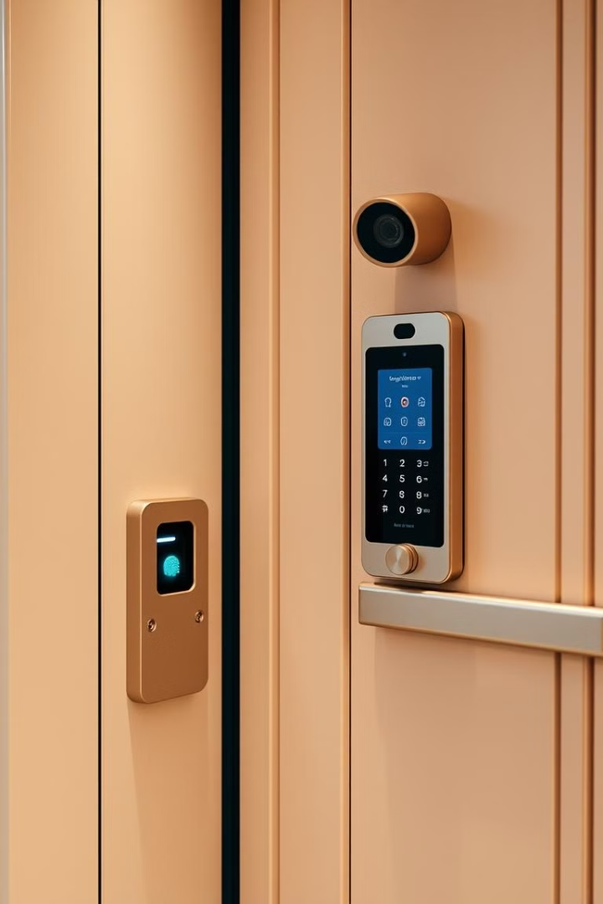
Introduction: Enhancing Security and Access Control
1
Secure Access
2
Increased Efficiency
Biometric identification via facial recognition provides a robust access control solution, preventing unauthorized entry.
Automated facial analysis streamlines security checkpoints, improving throughput and user experience.
3
Proactive Surveillance
Real-time face detection and recognition enables proactive monitoring for potential threats or suspicious activity.

Slide 4

Face Detection with Haar Cascades
Haar Cascade Classifier
Robust Performance
Leveraging OpenCV's pre-trained Haar Cascade Classifier to detect facial features in real-time video streams.
Capable of handling varying lighting conditions, angles, and occlusions to reliably identify faces.
1
2
3
Efficient Detection
The Haar Cascade approach quickly scans the image for facial patterns, enabling rapid face detection.

Slide 5
Face Encoding using face_recognition Library
Facial Encoding
Deep Learning Model
Accurate Matching
The face_recognition library generates a 128-dimensional encoding of detected faces, enabling comparisons and identification.
The encoding is produced by a deep neural network trained on a large dataset of facial images.
The encoded face data can be efficiently compared against a database to identify individuals with high accuracy.

Slide 6
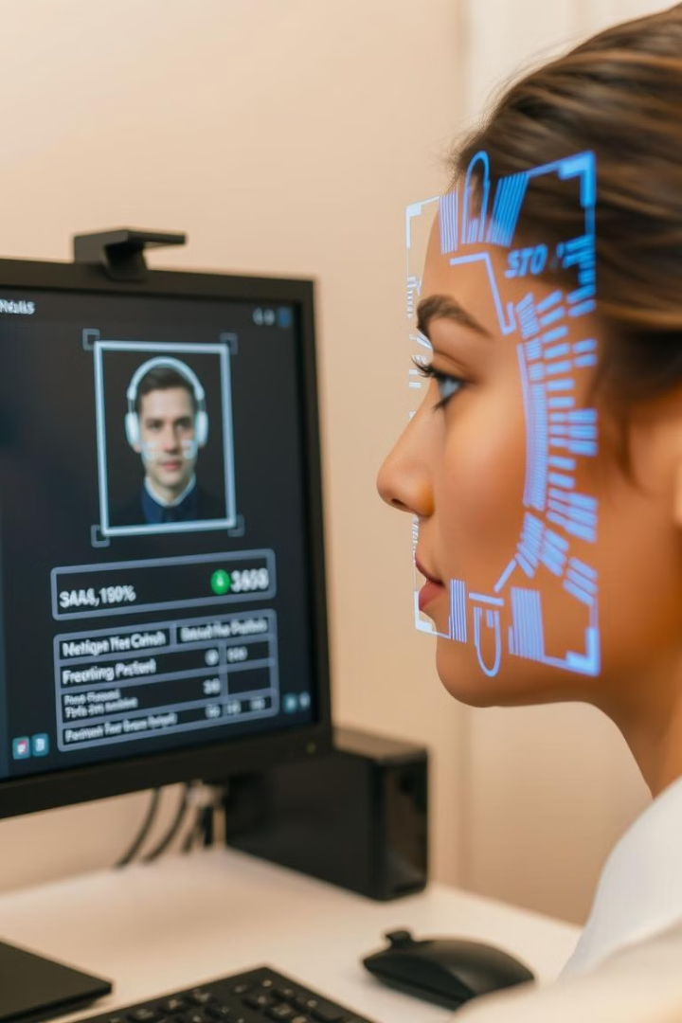
CSV Data Storage with Pandas
Facial Database
Efficient Lookup
Leveraging Pandas, a powerful data analysis library, to store and manage the facial encoding data in a CSV file.
The CSV database allows for fast and scalable retrieval of facial encodings for real-time identification.
Data Persistence
Easy Expansion
Storing the facial data in a persistent CSV file ensures the system can be restarted without losing critical information.
The modular CSV format makes it simple to add new facial data as the system grows and expands.

Slide 7
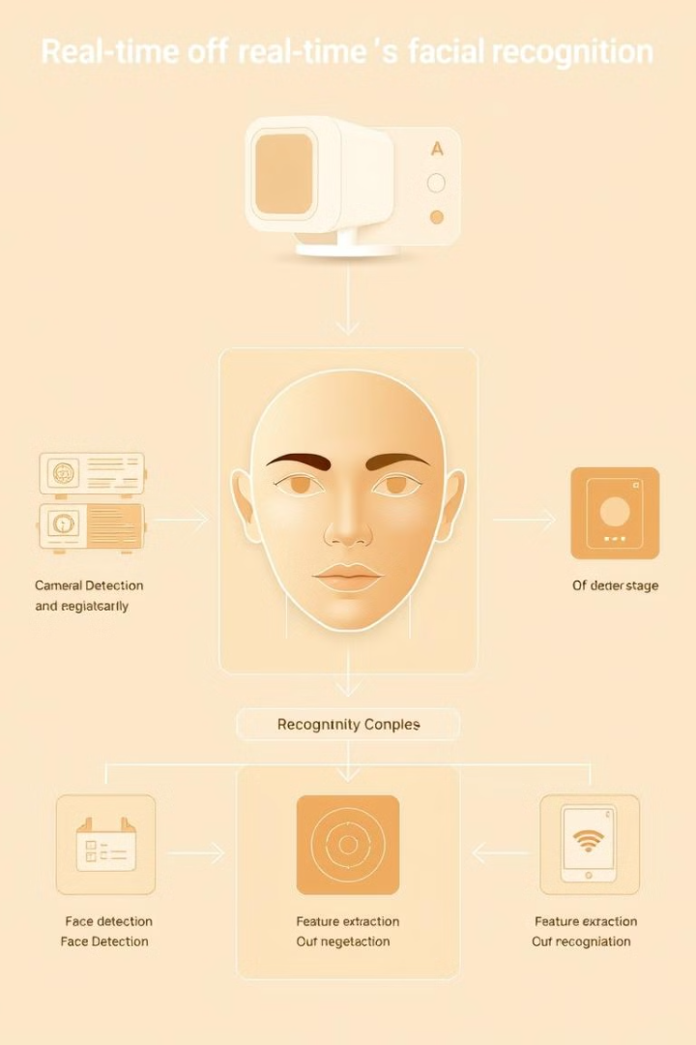




System Architecture and Technologies
Camera Input
Facial Analysis
Capturing real-time video feed for facial detection and recognition.
Utilizing OpenCV and the face_recognition library for computer vision tasks.
Data Storage
User Interface
Storing and retrieving facial encodings using a Pandas CSV database.
Providing a clear and intuitive display of the real-time facial recognition results.

Slide 8
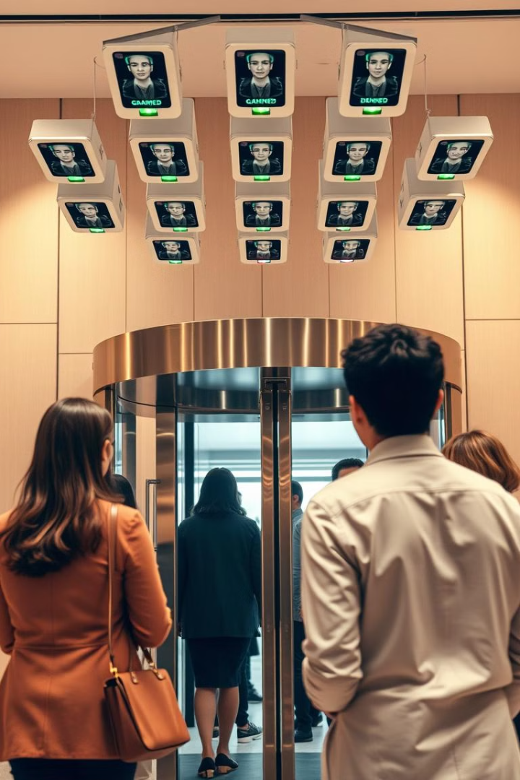




Demonstration and User Walkthrough
Facial Capture
The system continuously scans the environment for human faces.
Facial Encoding
Detected faces are encoded using the deep learning model.
Database Lookup
The encoded face is compared against the stored facial database.
Access Control
Granted or denied access based on the facial recognition results.

Slide 9
Potential Applications and Future Improvements
Access Control
Surveillance and Monitoring
Future Enhancements
Secure entry and exit management for buildings, facilities, and restricted areas.
Integrating with additional biometric modalities, improving accuracy, and expanding to mobile devices.
Proactive threat detection and identification in public spaces and critical infrastructure.

